Slide 1
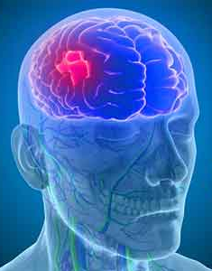
Stroke Prediction Introduction to Data Science Project Course Final Project
Can we predict whether a person will suffer a stroke
from biological variables and lifestyle?
Dorelle Afargan - 204005235
Eden Bar - 209037571

Slide 2
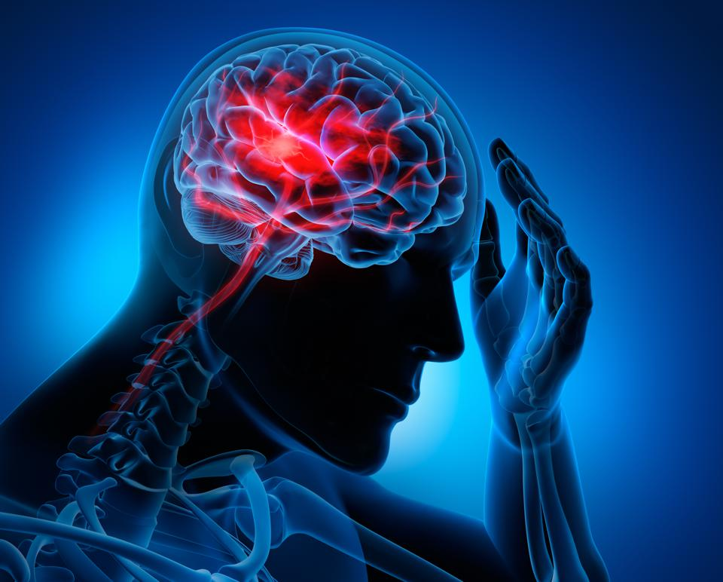
Background
According to the World Health Organization (WHO) stroke is the 2nd leading cause of death globally, responsible for approximately 11% of total deaths. Stroke is a medical emergency. A stroke occurs when blood flow to a part of the brain is interrupted or reduced, preventing brain tissue from getting oxygen and nutrients. Brain cells begin to die within minutes.
This dataset is used to predict whether a patient is likely to get a stroke based on the input parameters such as gender, age, various diseases, and smoking status and more.

Slide 3


Main Steps
Obtaining Data
Data Cleaning
EDA
Modeling Data
Interpreting
Data
1
2
3
4
5
We took a csv file from “Kaggle”
the world's largest data science community website.
Cleaning and filtering the data.
Visualizing and understanding the data.
Manipulating the data to fit modeling and ML algorithms
for best outcomes.
Presentation of data.
Understanding the results and prediction model.

Slide 4

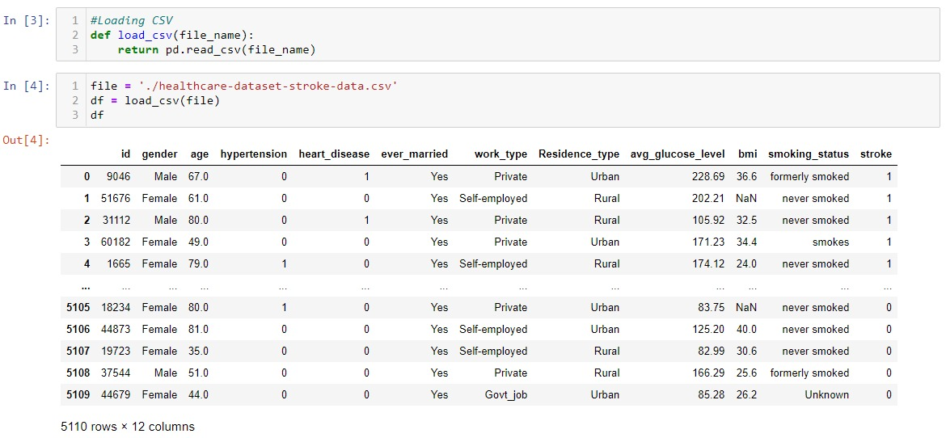
Obtaining Data
Loading the csv that contains the stroke data into Data frame.
We can now see our data set size 5110 by 12 variables.

Slide 5
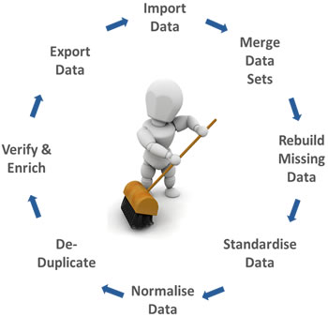
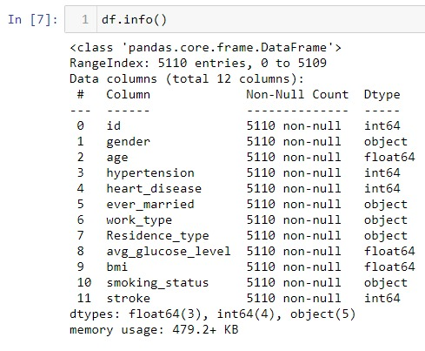
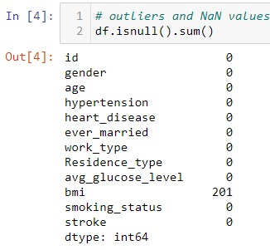
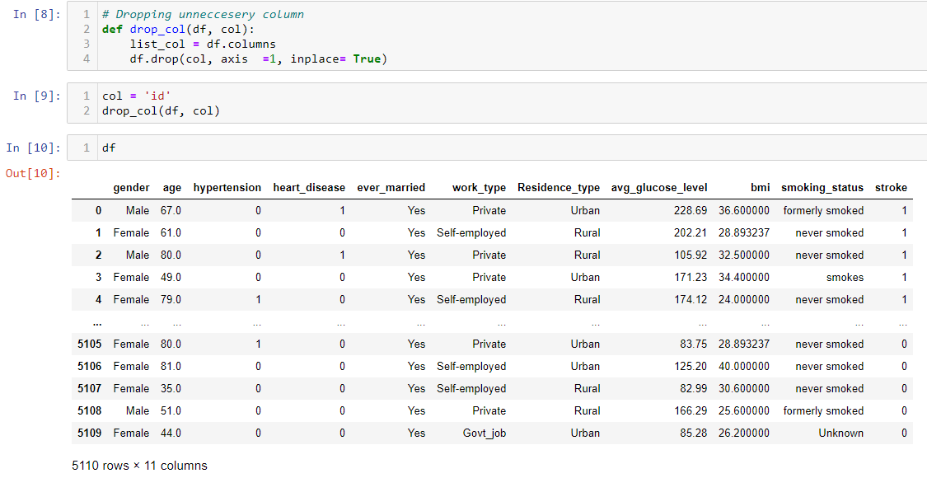
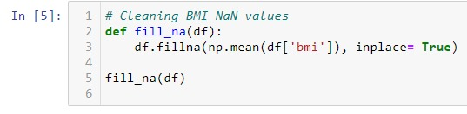
Data Cleaning
Looking for NaN values,
we can see that there are 201 BMI missing values,
replacing the NaN values with median of the BMI values.
Also we do not need “Id” column so we deleted it from the data

Slide 6
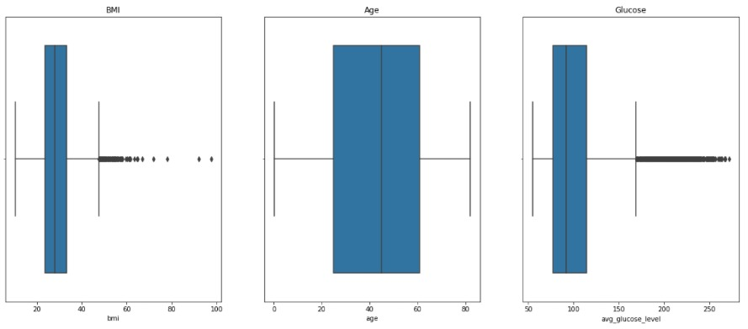
Data Cleaning
Using Boxplots we are looking for outliers.
We can observe that there are a lot of outliers in the BMI boxplot (BMI levels range from 19-60).
Other values such as Glucose level are important to our research, and are not really outliers.

Slide 7
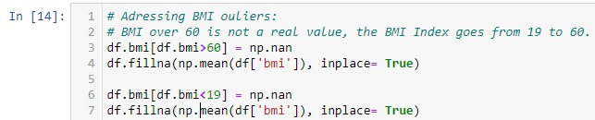
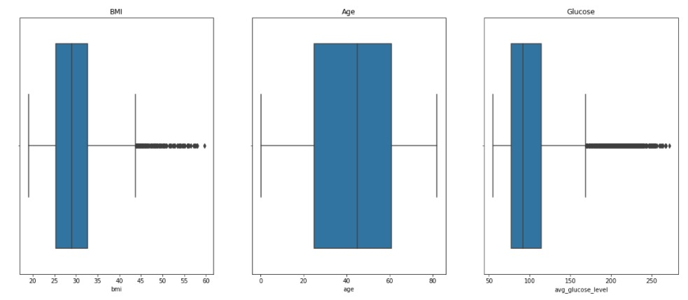
Data Cleaning
Replacing the outliers with the median values of BMI column.

Slide 8

Exploratory data analysis
From the data that we want to explore the following questions came to mind:
Subjects that smokes are more prone to having a stroke?
High Glucose levels affects the risk of having a stroke?
BMI levels affects the risk of having a stroke?
What gender is more likely to have a stroke?
A subject with heart disease is more prone to having a stroke?
Subjects living area affect the chance of having a stroke?
Hypertension is a cause of stroke?
Subjects jobs sector affect the chance of having a stroke?
Subjects of which age group are more likely to get a stroke?
Is marriage a cause of strokes?

Slide 9
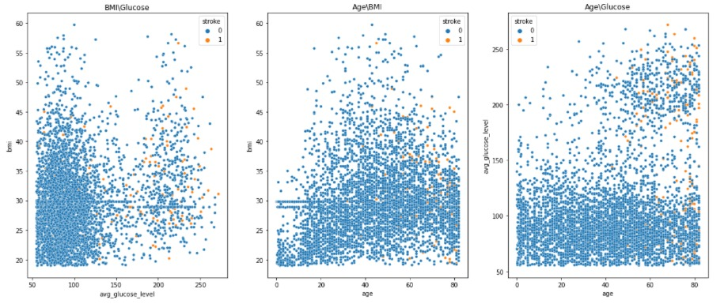
Exploring numeric data
Scatter plots between numeric values
We can see that the more older the subject is and the more high glucose levels in his blood, the more likely to having stroke.
We can see that that the more BMI the subject has and more high glucose levels, the more likely to having stroke.
We can see that the more older the subject is and the more high his BMI value, the more likely to having stroke.
Those Scatter plots answers 3 questions that we asked:
High Glucose levels affects the risk of having a stroke?
BMI levels affects the risk of having a stroke?
Patients of which age group are more likely to get a stroke?

Slide 10
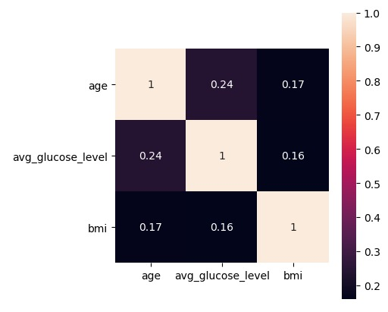
Exploring numeric data
Using Heatmap plot:
We can look at the correlation between the numeric variables
We can observe that there is not much correlation, however the highest correlation are between Glucose\Age.
Through that we can understand that there is a factor of people older having higher glucose blood levels and that can affect them of having a stroke.

Slide 11
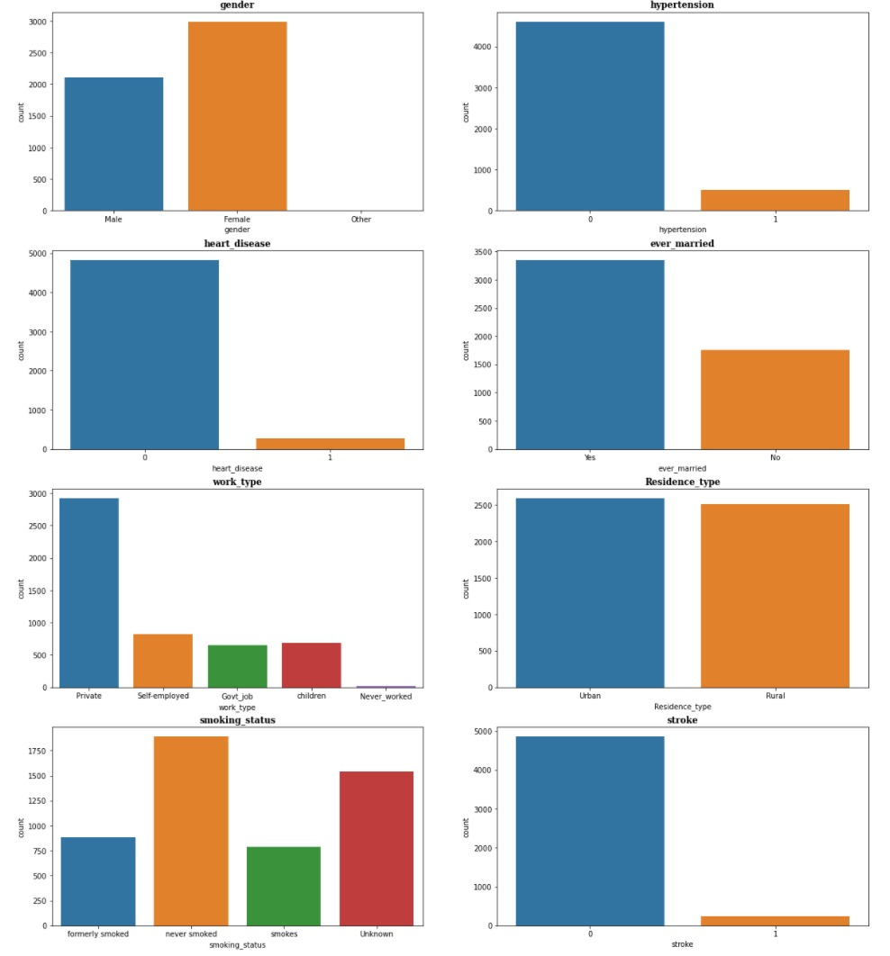
Exploring categorial data
Gender:
There are more females than males.
Hypertension:
There are not a lot of subjects who has Hypertension.
Heart disease:
There are not a lot of heart disease among the subjects.
Martial Status:
The subjects who are married is way more than
unmarried subjects, the average age is 43
Work Type:
There are more subjects working in private
sectors, the number of other sectors and children
are kind of equal. Unemployed is very small.
Living Area:
There is about the same amount of subjects living
in urban or rural area.
There is a lot of Unknown category in the smoking
status.
Smoking Status:
Never smoked are more than subjects who
smoked/used to smoke.
Stroke:
Number of subjects who had a strokes are less
than 1000.

Slide 12
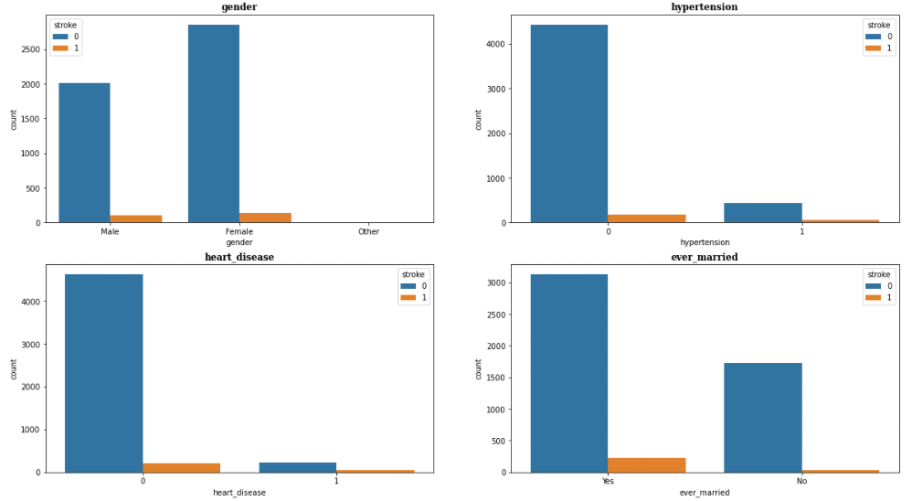
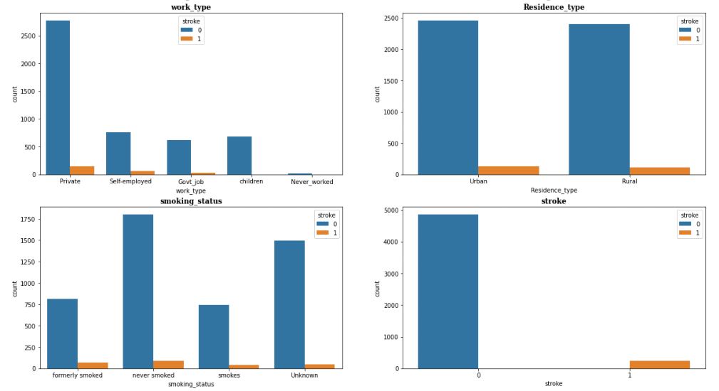
Exploring categorial data
After exploring categorial data we can see the following:
There is no obvious tendency to other gender to have a stroke.
Subjects who do not have Hypertension having less stroke.
Subjects who has heart disease are more likely to have a stroke.
Subjects who got married show tendency to stroke way more than people who are unmarried (makes sense the avg age is 43.)
Private sector employees seems to experience stroke more than other work sectors. Self-employed people do show signs of stroke, Children and never worked are ignored.
Almost no difference between subjects living in urban and rural areas in terms of stroke.
Subjects who formerly smoked and smokes (combined) are showing tendency of having a stroke way more than people who never smoked.

Slide 13
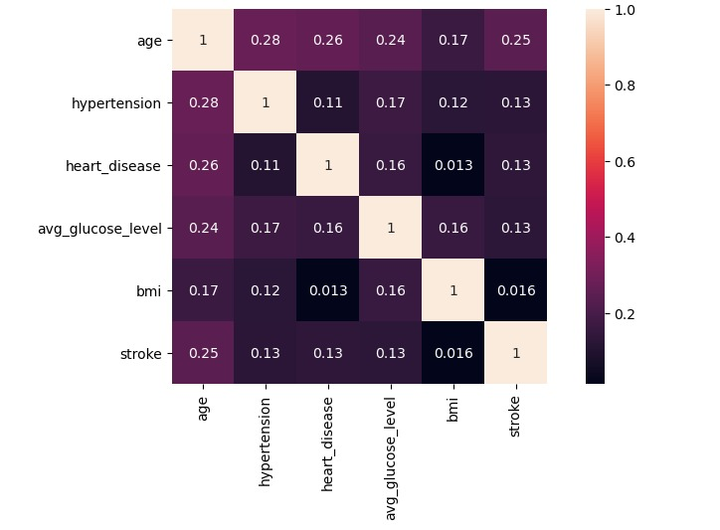
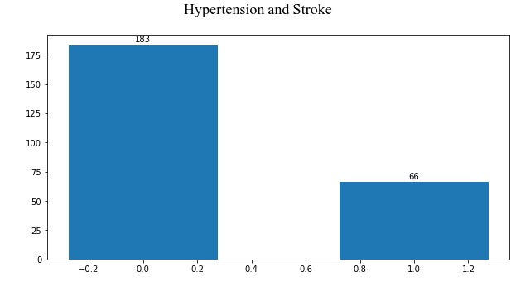
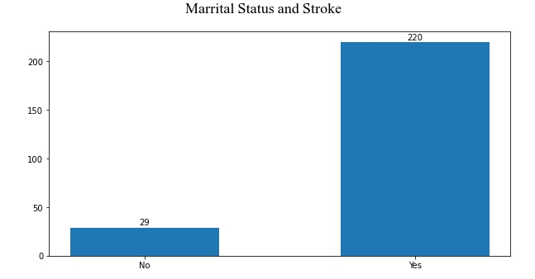
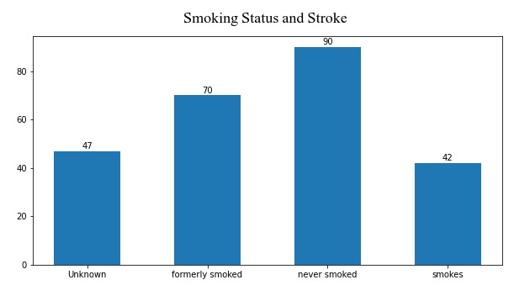
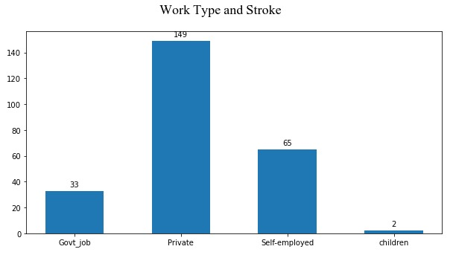
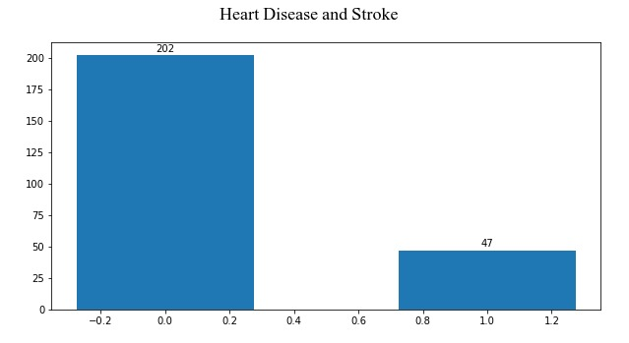
Exploring categorial data

Slide 14
Exploring categorial data
After counting the stroke events and Heatmap correlation in categorial data we can see the following:
No strong correlation between our variables .
The highest correlation can be observed between age and hypertension (make sense the more you are older the more stress you may have).
The weakest correlation can be observed between Heart disease and BMI.

Slide 15
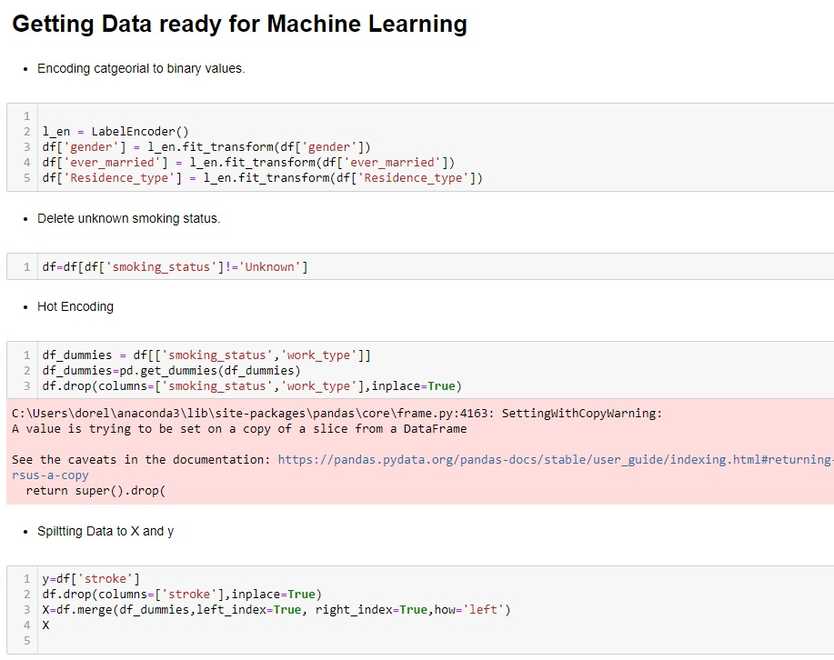

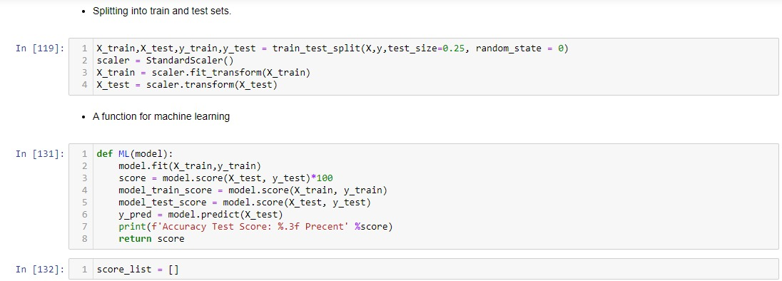
Machine Learning
Getting Data ready for Machine Learning:
In order for the models to be accurate as possible we need to do few steps:
Label Encoding data to binary.
Deleting unnecessary data.
Hot Encoding categorial values.
Splitting Data to X, y.
Splitting to Train and Test.
Creating a function that receives a model and returns a score.

Slide 16
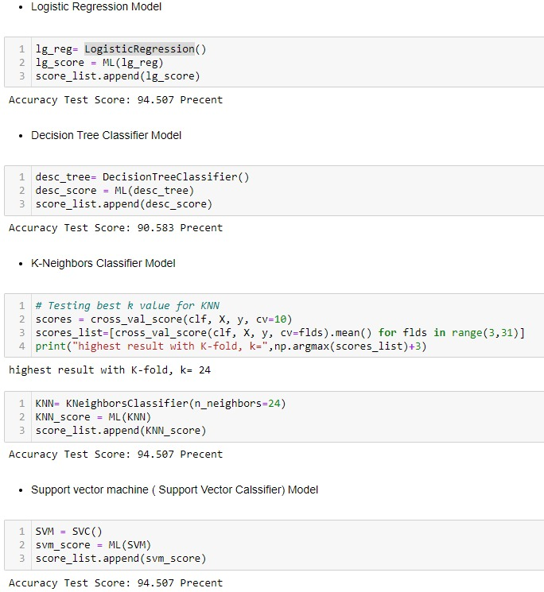
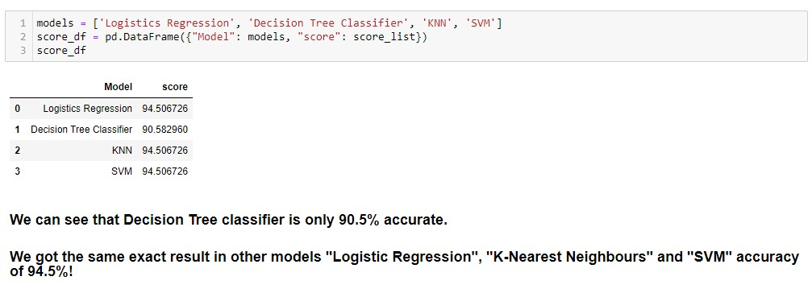
Machine Learning
Machine Learning Algorithms:
We decided to use 4 Models for prediction:
Logistic Regression.
Decision Tree Classifier.
K-Neighbor Classifier.
Support vector machine (Support vector Classification)
Prediction:
DTC with 90.5% accuracy.
The other algorithms prediction is 94.5% accuracy.

